Slide 1
Computer Graphics & IMAGE PROCESSING
CST304
Module - 1 Part -2
Video Display devices:-
Refresh Cathode Ray Tubes
Random Scan Displays and systems
Raster Scan Displays and systems

Slide 2

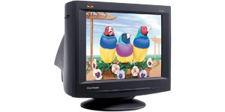
Video Display Devices
The primary output device in a graphical system is the video monitor.
The operation of most video monitors is based on the standard Cathode-Ray Tube (CRT) design.

Slide 3
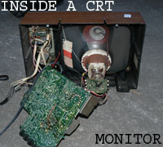
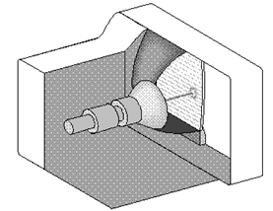
Cathode-Ray Tubes (CRT)

Slide 4
Cathode Ray Tube (CRT)
A cathode ray tube (CRT) contains four basic parts:
electron gun,
focusing and accelerating systems,
deflecting systems, and
evacuated glass envelope with a phosphor coated screen that glows visibly when struck by the electron beam

Slide 5
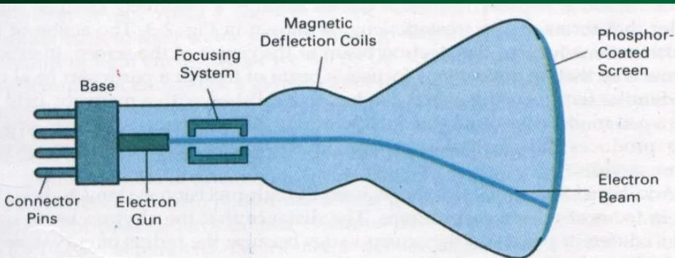
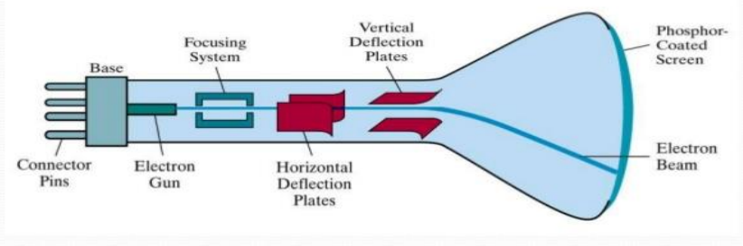
Figure :- Magnetic Deflection CRT
Figure :- Electrostatic Deflection CRT

Slide 6
Basic operations of a CRT
The electron gun emits a beam of electrons (cathode rays).
The electron beam passes through focusing and deflection systems that direct it towards specified positions on the phosphor-coated screen.
When the beam hits the screen, the phosphor emits a small spot of light at each position contacted by the electron beam. (Because the light emitted by the phosphor fades very quickly some method is needed for maintaining the screen picture).
One way to keep the phosphor glowing is to redraw the picture repeatedly by quickly directing the electron beam back over the same points(refreshing). This type of display is called a refresh CRT.
Notes:
Focusing system in anode(+ve)

Slide 7
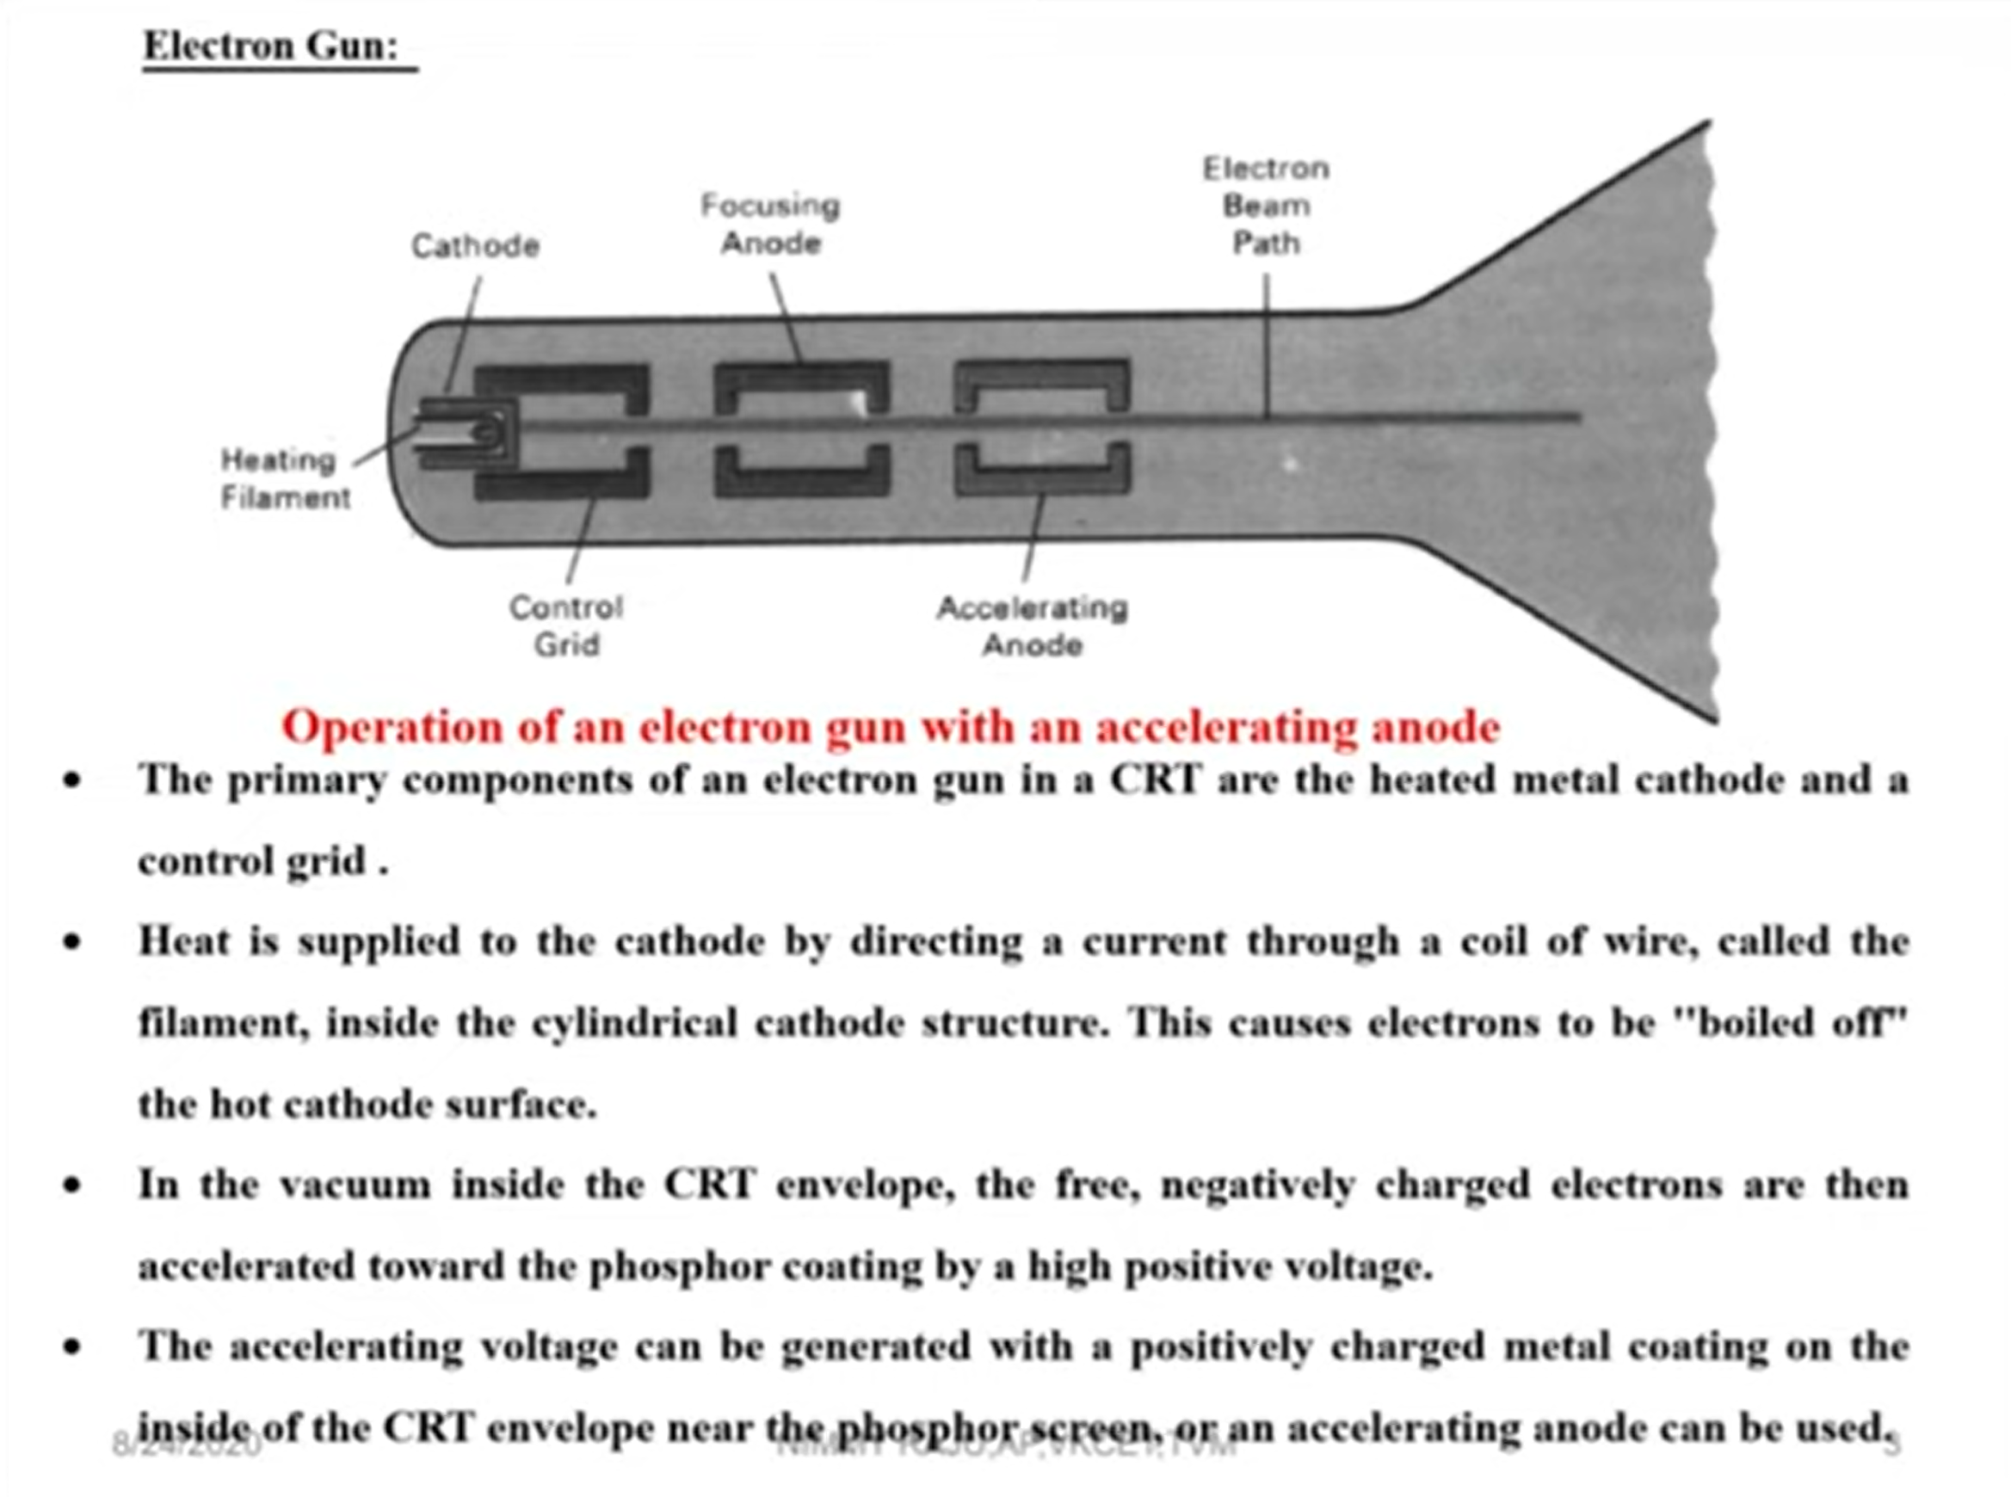
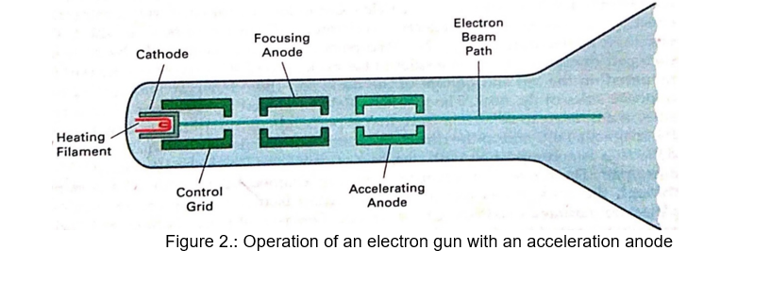


Slide 8
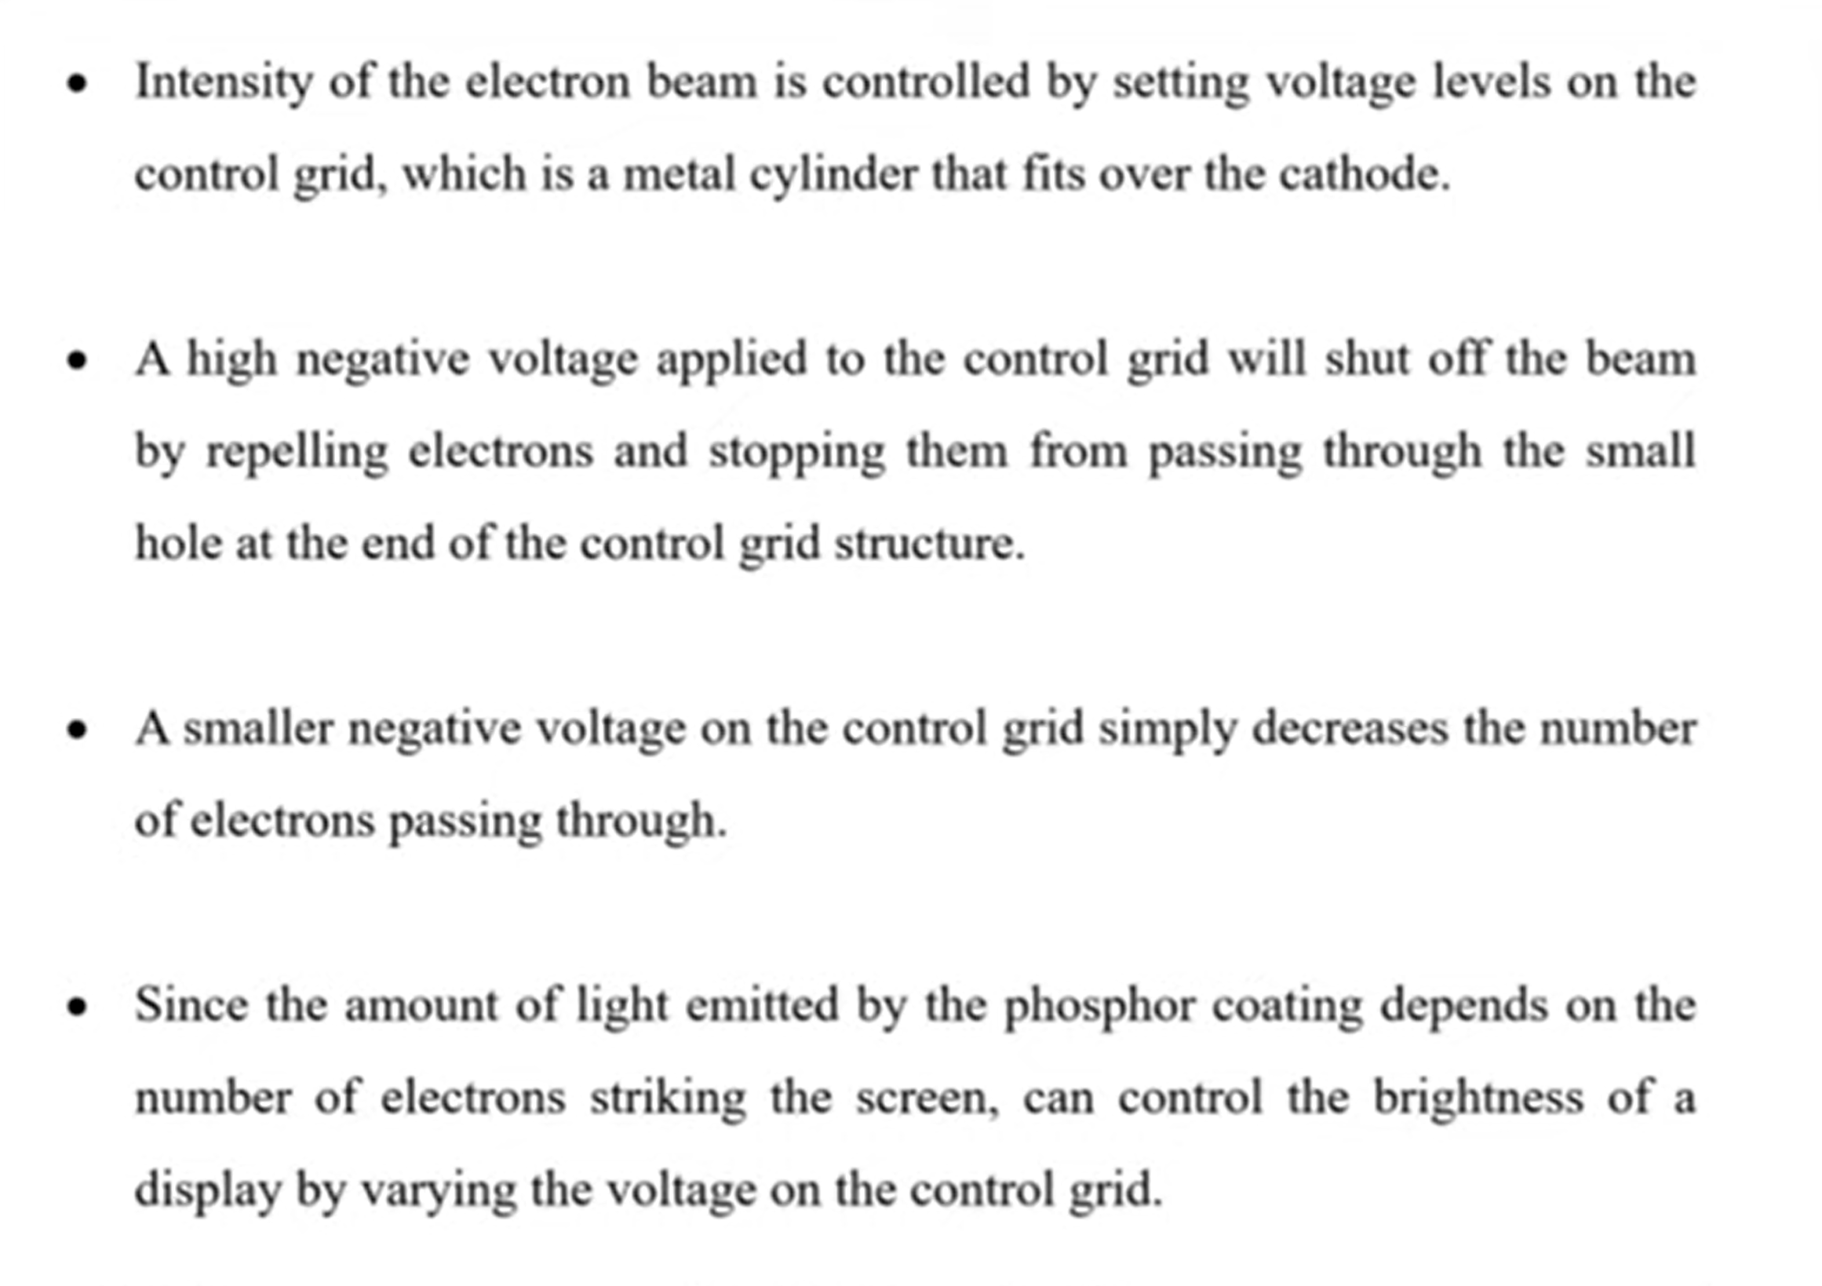

Slide 9
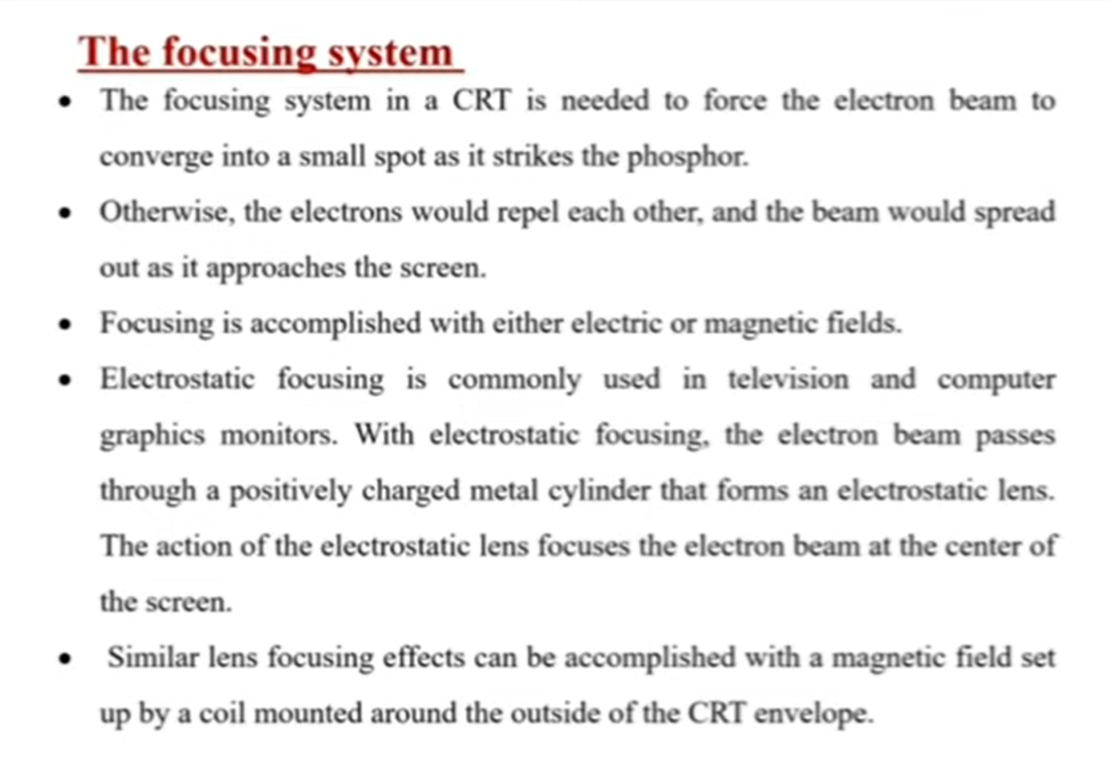

Slide 10
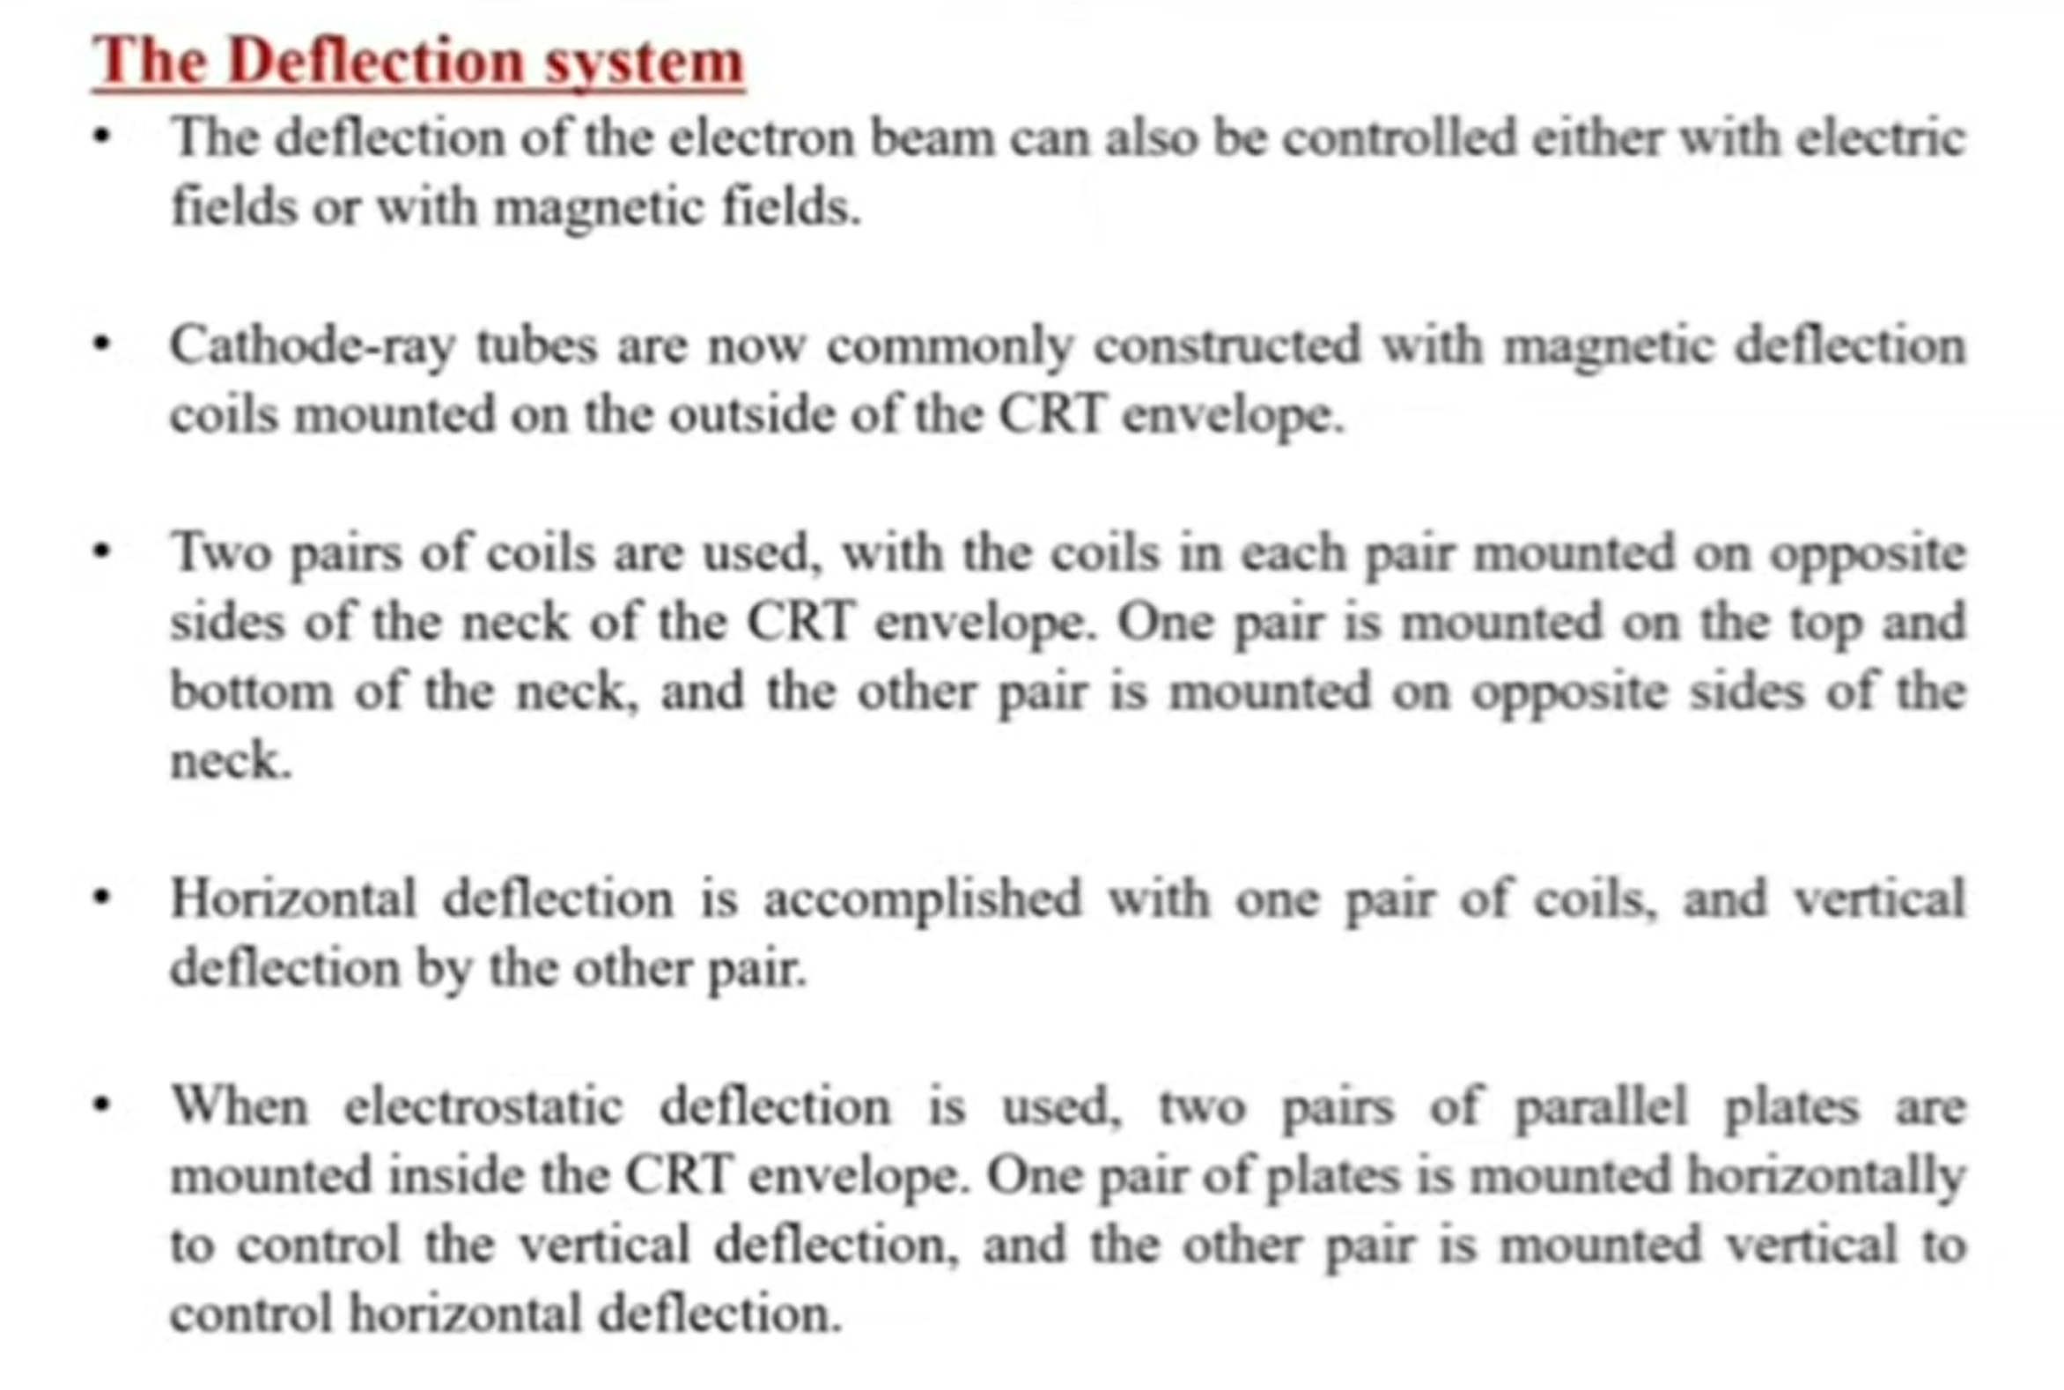

Slide 11
Phosphor Persistence
Different kinds of phosphors are available for use in a CRT.
Besides color, a major difference is their persistence – how long they continue to emit light after the CRT beam is removed.
Persistence is defined as the time it takes the emitted light from the screen to decay to one-tenth of its original intensity
A phosphor with low-persistence is useful in animation.
A high-persistence phosphor is useful for displaying highly complex, static pictures.
Graphics monitors are usually constructed with a persistence in the range from 10 to 60 microseconds.

Slide 12
Brightness (Intensity) distribution of an illuminated phosphor spot on a CRT Screen
The intensity is greater at the center of the spot, and it decreases with Gaussian distribution out to the edges of the spot.

Slide 13

Resolution
Resolution- The maximum number of points (pixels) that can be displayed without overlap on a screen, and determines the detail that can be seen in an image.
Determines Clarity of image
A more precise definition is the number of points per centimeter that can be plotted horizontally and vertically, although it is often simply stated as the total number of points in each direction (i.e. 1280 × 1024).
The physical size of a graphics monitor, is given as the length (in inches) of the screen diagonal.
Resolution depends on type of phosphor, intensity to be displayed, and focusing and deflection systems.

Slide 14
Aspect Ratio
Aspect ratio gives the ratio of horizontal points to vertical points necessary to produce equal-length lines in both directions on the screen.
Aspect ratio 4:3 (most common) means that a horizontal line plotted with 4 points has the same length as a vertical line plotted with 3 points.

Slide 15
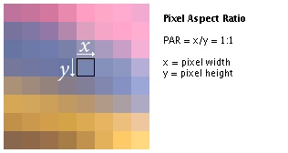
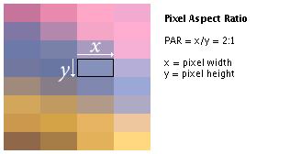
Aspect Ratio
Frame aspect ratio (FAR) = horizontal/vertical size
    TV 4:3
    HDTV 16:9
Pixel aspect ratio (PAR) = pixel width/ pixel height

Slide 16
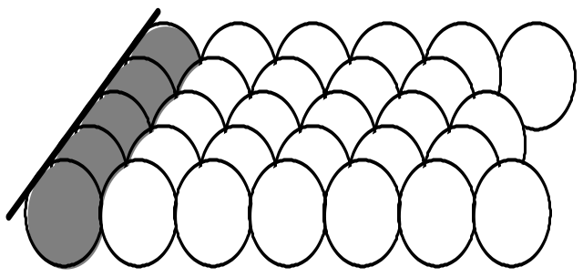
Addressability
Addressability is the number of individual dots per inch (d.p.i.) that can be created.
The picture on a screen consists of intensified points.
The smallest addressable point on the screen is called pixel or picture element
Notes:
Addressability is a measure of the spacing between the centers of vertical and horizontal lines.
In graphics mode there are 800x600

Slide 17
Refresh Rate
Definition: The number of times per second the image is redrawn.
The entire contents of the frame buffer are displayed on the CRT at a rate high enough to avoid flicker. This rate is called the refresh rate.
For a human to see a steady image on most CRT displays, the same path must be retraced, or refreshed, by the beam at least 60 times per second.
Current raster-scan displays perform refreshing at the rate of 60 to 80 frames per second, although some systems now have refresh rates of up to 120 frames per second.
Refresh rates are described in units of cycles per second, or Hertz (Hz), where a cycle corresponds to one frame (i.e. a refresh rate of 60 frames per second = 60 Hz).

Slide 18
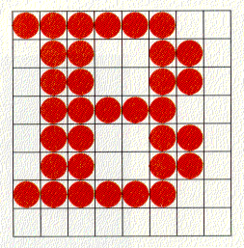
Raster Scan Displays
Developed in the early seventies, today's dominant hardware technology. Almost all graphics systems are raster-based.
A picture is produced as an array - raster of picture elements.
This elements are called Pixels or Pels (Picture Elements).
A pixel corresponds to a location, or small area, in the image
Pixel - Dot on screen, Is addressable, Can be illuminated
  More pixels means higher resolution
Dot pitch - distance between dots
  Smaller distance means better quality image
Collectively, the pixels are stored in a part of memory called the refresh buffer or frame buffer.

Slide 19
The Frame Buffer
0
800
0
x
pixel at address (x,y)
spot at (x,y)
600
y
Frame buffer
Display surface
at (800,600)

Slide 20
    The number of bits per pixel in the frame buffer is called depth or bit planes
Determines properties such as how many colors can be represented on a given system.
    Buffer with 1 bit per pixel (1-bit-deep) – Bitmap allows 2¹ colors (black and white)
    Buffer with multiple bits per pixel (8-bit-deep) – Pixmap allows 2⁸ colors (=256)
  Full color (RGB-color systems), 24 (or more) bits per pixel in order to display sufficient colors to represent most images realistically.
(On a black-and-white system with one bit per pixel, the frame buffer is commonly called a bitmap. For systems with multiple bits per pixel, the frame buffer is referred to as a pixmap)

Slide 21
Raster Scan Displays
They are based on TV technology Eg: Home TV sets, Printers
Refresh rate = 60 to 80 frames per second.
  Note: Below 24 frames/second, eye detects flicker.
  In raster scan system, electron beam sweeps across the screen one row at a time from top to bottom, is referred to as a scan line. As the electron beam moves across each row, the beam intensity is turned on and off to create a pattern of illuminated spots.
  Picture definition is stored in frame buffer/ refresh buffer, and stored intensity values are retrieved and painted on the screen one row(scan line) at a time.
  Each screen point is called as pixel (picture element) and is visited every refresh cycle.
Capable to store intensity information for each screen point, so well suited for the realistic display of scenes (shading and color patterns).

Slide 22
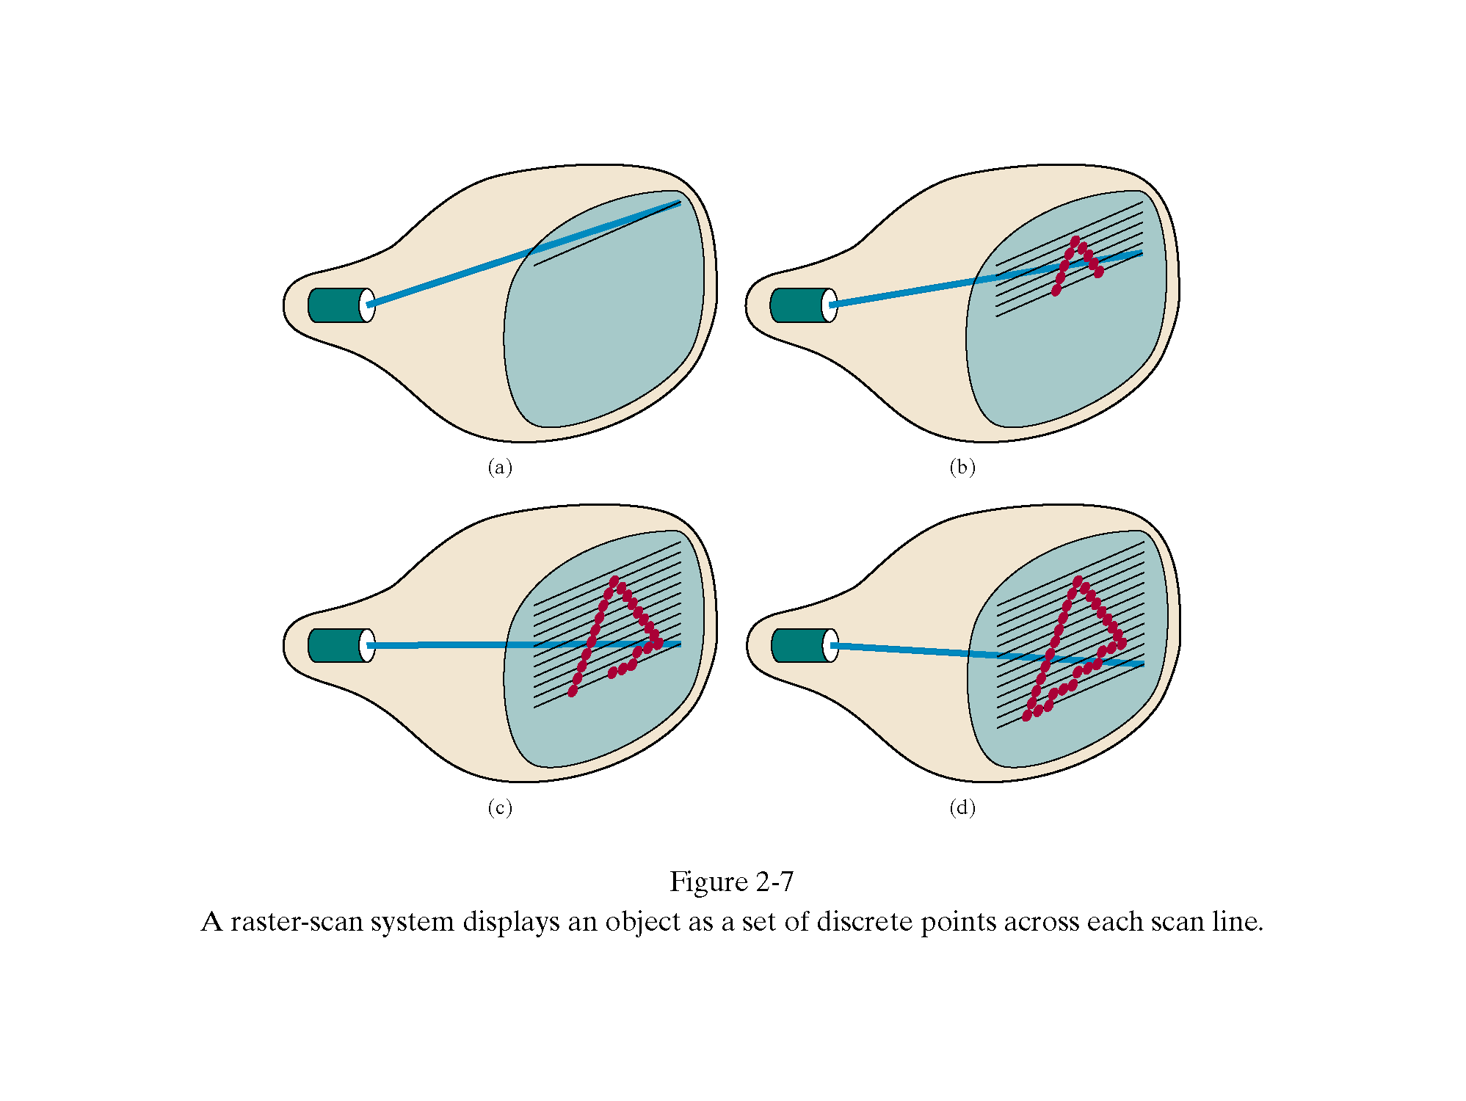
Raster- Scan Displays….
Electron beam sweeps across the screen one row at a time from top to bottom is referred to as a scan line
At the end of each scan line, the electron beam returns to the left side of the screen to display the next scan line (horizontal retrace)
At the end of each frame, the electron beam returns to the top-left corner of the screen to display the next frame (vertical retrace)
Scan line
Horizontal
retrace
Vertical
retrace

Slide 23
Interlaced Raster Scan Displays
To reduce flicker, divide the frame into two fields—one consisting of the even scan lines and the other of the odd scan lines.
Even and odd fields are scanned out alternately to produce an interlaced image. Odd/even scan lines are covered in successive refresh cycles.
Hence 30 frames/sec refresh rate appears like 60 frames/sec.
0
1
2
3
4
5
6

Slide 24
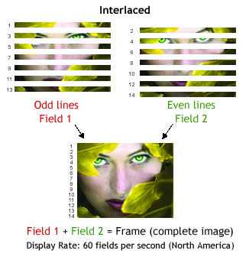

Slide 25
Interlaced vs. Non-interlaced
Interlaced
  Refresh every other line on each pass
  Lower refresh rate without flicker
  Good for fixed graphics
  Causes flutter with animated graphics
  Inexpensive
Non-interlaced
  Refresh every line on each pass
  Typical screen sold today

Slide 26
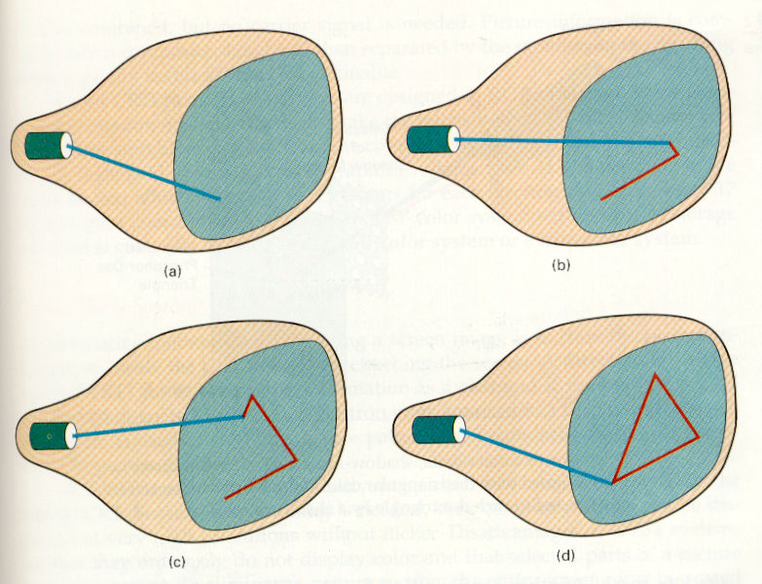
Random-Scan (Vector) displays
Vector stands for line.
Developed in the mid-60’s and in common use until the mid- 80’s
The electron beam is directed only to parts of the screen where the picture is to be drawn.
MoveTo (300,800)
LineTo (700,800)
LineTo (500,300)
LineTo (300,800)

Slide 27
Random Scan Displays
  Electron beam is directed only to the points of picture to be displayed.
Picture is stored as a set of point and line-drawing commands with (x,y) or (x,y,z) endpoint coordinates, as well as character-plotting commands.
    This storage is referred as display list, refresh display file, vector file or display program
    To display a specified picture, the system cycles through the set of commands in display list, draw lines and refreshes it.
Refresh rate depends on the number of lines to be displayed. To avoid flicker it must be at least 30 times per second (30 Hz).

Slide 28
Random Scan Displays
They are designed to draw all the component lines of a picture 30 to 60 times per second – more than 60 could burn the phosphor.
High quality vector systems are capable of handling approximately 1,00,000 lines at this refresh rate.
They are designed for smooth line drawing applications
These systems have higher resolution
They cannot display realistic shaded images

Slide 29
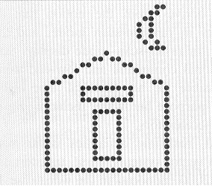
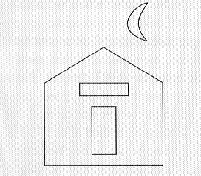
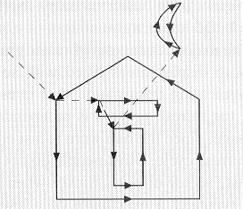
Raster Scan Vs Random Scan
Raster scan
Ideal line drawing
Random scan

Slide 30
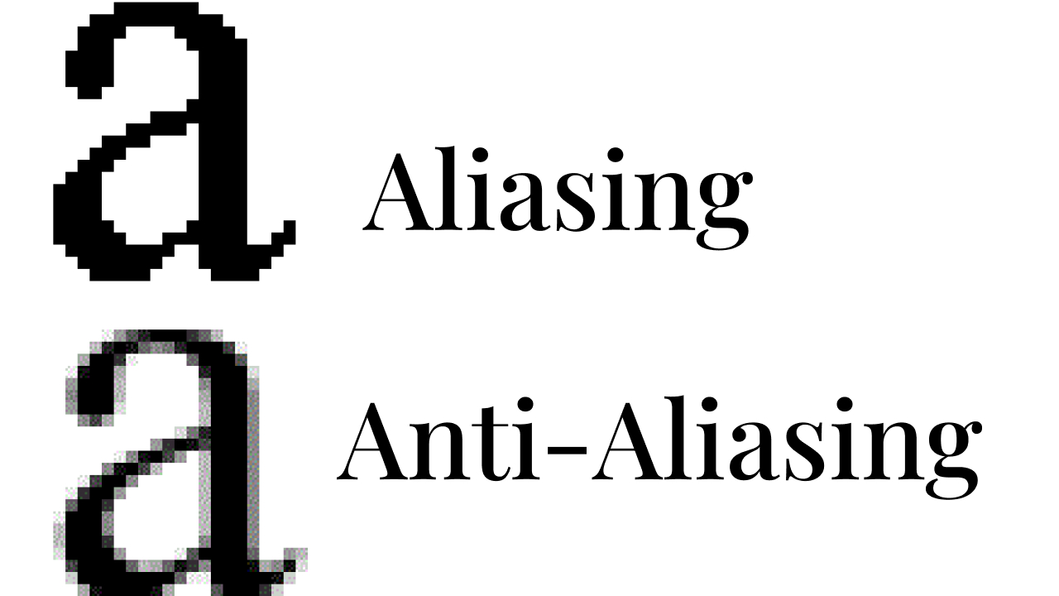
Raster Scan Vs Random Scan
Advantages of Raster Displays
  Low cost (memory has become cheap)
  Refresh rate is independent of image complexity(vector complexity is limited by refresh rate )
  Can handle colour and filled areas
Disadvantages of Raster Displays
  Uses more memory
  Mathematical models of objects must be scan converted by the host processor
  Aliasing or "jaggies" arises due to sampling error when converting from a continuous to a discrete representation

Slide 31
Comparing Raster and Vector
Advantages of Vector displays:
  very fine detail of line drawings (sometimes curves), whereas raster suffers from jagged edge problem due to pixels
  Higher resolution
  Handles geometry objects (lines) whereas raster only handles pixels
    eg. 1000 line plot: vector display computes 2000 endpoints
  raster display computes all pixels on each line
  Disadvantages of Vector displays
  vector complexity is limited by refresh rate
  cannot display realistic shaded scenes
Notes:
(aliasing, quantization errors)

Slide 32
Random Scan | Raster Scan
1. It has high Resolution | 1. Its resolution is low.
2. It is more expensive | 2. It is less expensive
3. Any modification if needed is easy | 3.Modification is tough
4. Solid pattern is tough to fill | 4.Solid pattern is easy to fill
5. Refresh rate depends on picture | 5. Refresh rate does not depend on the picture.
6. Only screen with view on an area is displayed. | 6. Whole screen is scanned.
7. Beam Penetration technology | 7. Shadow mask technology
8. It does not use interlacing method. | 8. It uses interlacing
9. It is restricted to line drawing applications | 9. It is suitable for realistic displays.
10. Pen Plotter | 10. TV, Printer

Slide 33
The Bit-map
1-bit-deep frame-buffer
1 | 1 | 1 | 1 | 1 | 1 | 0 | 0
0 | 1 | 1 | 0 | 0 | 1 | 1 | 0
0 | 1 | 1 | 0 | 0 | 1 | 1 | 0
0 | 1 | 1 | 1 | 1 | 1 | 0 | 0
0 | 1 | 1 | 0 | 0 | 1 | 1 | 0
0 | 1 | 1 | 0 | 0 | 1 | 1 | 0
1 | 1 | 1 | 1 | 1 | 1 | 0 | 0
0 | 0 | 0 | 0 | 0 | 0 | 0 | 0
Frame buffer
Pixels

Slide 34
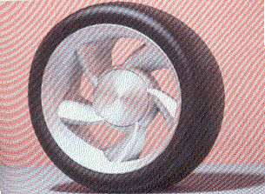

Gray Level Images
n-bits per pixel produce 2^{n} gray levels.
Many images use 8-bits per pixel, i.e. 256 gray levels since it gives acceptable quality.
00
01
10
11
2-bit per pixel
4 gray level
Color image
8-bit per pixel
256 gray level
1-bit per pixel
2 gray levels
Black & White

Slide 35
Color Images
Produce realistic images.
Cost of high-quality color displays has decreased.
Cost of scanners that digitize color photos has decreased.
Each pixel in a color image has a “color value” which is a combination of amounts of red, green and blue.
Each pixel value is an ordered triple, such as (23,14,51), that prescribes the densities of the red, green and blue.
Each value in the triple (RGB) has a certain number of bits, and color depth is the sum of these values.

Slide 36
The Color Depth
Many images have a color depth of eight (one byte), 3 bits-red, 3 bits - green and 2 bits for the blue. Each pixel has one of 256 colors.
In highest quality (true-color) images, have a color depth of 24, one byte for each component.
  This achieves the best color production the eye can perceive: More bits do not improve an image.
x
pixel value
y
Color depth = 6 bits ➔ 2⁶ (= 64) colors

Slide 37
Common Colors
Color depth of three
One bit for each component
Color Value (triple) | Value
0,0,0 | Black
0,0,1 | Blue
0,1,0 | Green
0,1,1 | Cyan
1,0,0 | Red
1,0,1 | Magenta
1,1,0 | Yellow
1,1,1 | White

Slide 38
Tutorial 1
1)How many bits are required for 1024×1024 raster with each pixel being represented by 24 bits ?
2)Suppose you have a raster system designed using an 8 inches × 10 inches screen with a resolution of 100 pixels per inch in each direction. What frame buffer size is required if 6 bits are stored per pixel in the buffer?

Slide 39
How many bits are required for 1024×1024 raster with each pixel being represented by 24 bits ?
Bits required =1024 x 1024 x 24 =25165824 bits

Slide 40
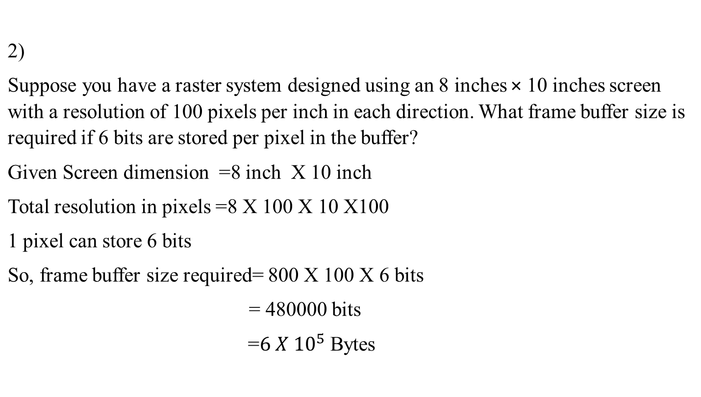

Slide 41
Color CRT Monitors
CRT monitors displays color pictures, by using a combination of phosphors that emit different-colored light.
The two basic techniques for producing color displays with a CRT
Beam-penetration method
  Used in random-scan monitors
  Use red and green phosphors layers
  Only 4 colours- RED, GREEN, YELLOW AND ORANGE
  Color depends on the penetrated length of electrons
Shadow mask method
  Used in raster-scan systems
  Produce wide range of colors with RGB color model

Slide 42
Color CRT – Beam penetration method
  Beam penetration method is used with random-scan monitors.
  Two layers of phosphor, usually red and green, are coated onto the inside of the CRT screen, and the displayed color depends on how far the electron beam penetrates into the phosphor layers.
  A beam of slow electrons excites only the outer red layer. A beam of very fast electrons penetrates through the red layer and excites the inner green layer. At intermediate beam speeds, combinations of red and green light are emitted to show two additional colors, orange and yellow.
  The speed of the electrons, and hence the screen color at any point, is controlled by the beam-acceleration voltage.
  This is an inexpensive way to produce color in random-scan monitors, but only four colors are possible, and the quality of pictures is not as good as with other methods.

Slide 43
Color CRT - Shadow Mask method
Shadow-mask methods are commonly used in raster scan systems (including color TV) because they produce a much wider range of colors than the beam penetration method.
A shadow-mask CRT has three phosphor color dots at each pixel position.
One phosphor dot emits a red light, another emits a green light, and the third emits a blue light.
This type of CRT has three electron guns, one for each color dot, and a shadow-mask grid just behind the phosphor-coated screen.

Slide 44
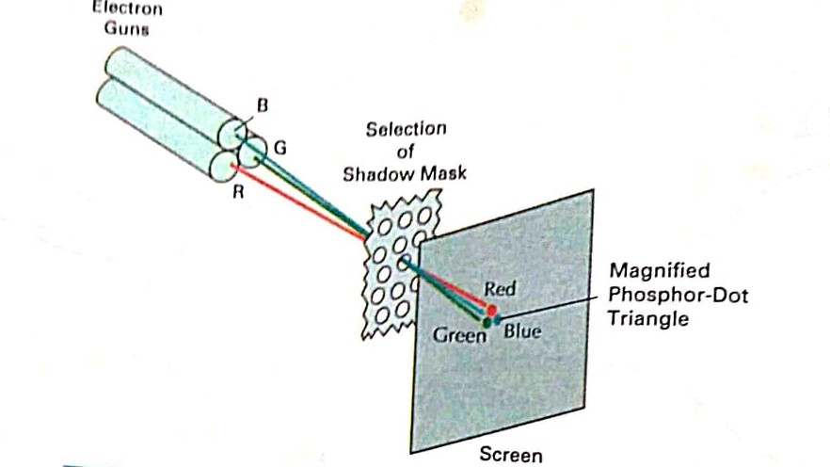
Operation of a delta-delta, shadow-mask CRT. Three electron guns, aligned with the triangular color dot patterns on the screen, are directed to each dot triangle by a shadow mask.

Slide 45
The three electron beams are deflected and focused as a group onto the shadow mask, which contains a series of holes aligned with the phosphor-dot patterns.
When the three beams pass through a hole in the shadow mask, they activate a dot triangle, which appears as a small color spot on the screen.
The phosphor dots in the triangles are arranged so that each electron beam can activate only its corresponding color dot when it passes through the shadow mask.
In-line arrangement the three electron guns, and the corresponding red-green-blue color dots on the screen, are aligned along one scan line instead of in a triangular pattern.
This in-line arrangement of electron guns is easier to keep in alignment and is commonly used in high-resolution color CRT.
We obtain color variations in a shadow-mask CRT by varying the intensity levels of the three electron beams

Slide 46
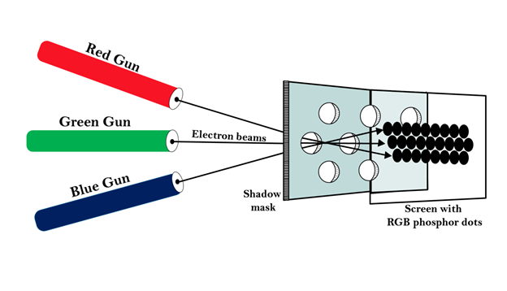
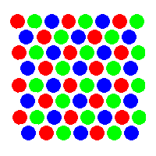
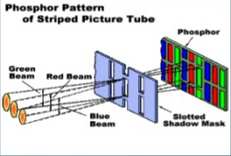
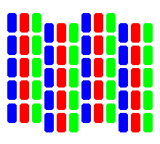
Shadow Mask Methods
Delta electron gun arrangement
In-line electron gun arrangement

Slide 47
Delta-delta vs Inline
The delta-delta shadow-mask method, commonly used in color CRT systems.
The three electron beams are deflected and focused as a group onto the shadow mask, which contains a series of holes aligned with the phosphor-dot patterns. When the three beams pass through a hole in the shadow mask, they activate a dot triangle, which appears as a small color spot on the screen.
The phosphor dots in the triangles are arranged so that each electron beam can activate only its corresponding color dot when it passes through the shadow mask.
Another configuration for the three electron guns is an in-line arrangement.
This in-line arrangement of electron guns is easier to keep in alignment and is commonly used in high-resolution color CRTs.

Slide 48
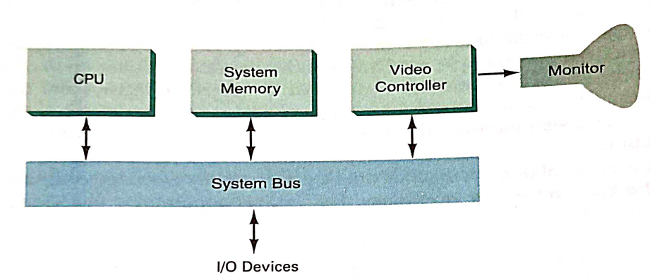
Raster-Scan systems
Interactive raster graphics systems employ several processing units.
In addition to the CPU, a special-purpose processor, called the video controller or display controller, is used to control the operation of the display device
Architecture of a simple raster graphics system

Slide 49
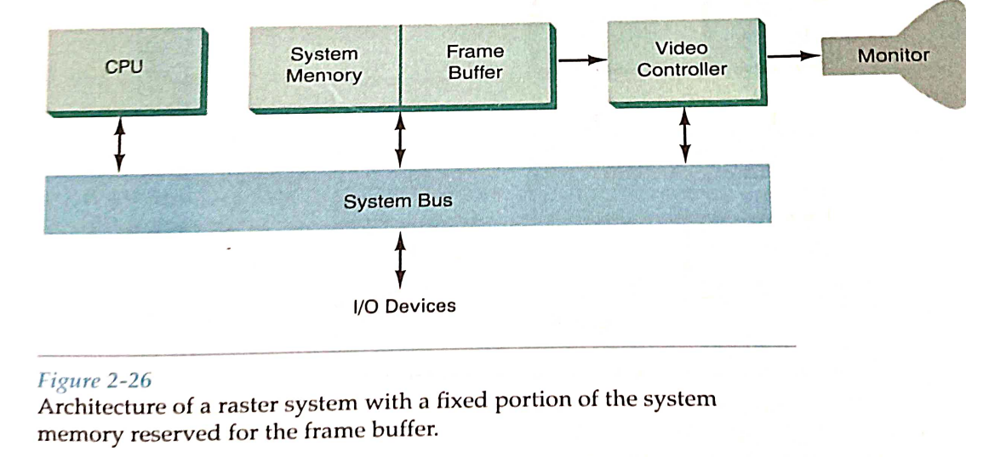
Raster-Scan systems

Slide 50
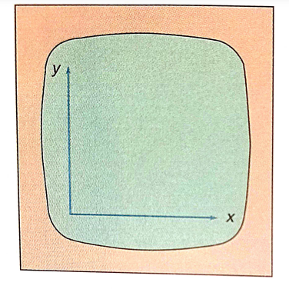
Raster-Scan systems…
A fixed area of the system memory is reserved for the frame buffer, and the video controller is given direct access to the frame-buffer memory.
Frame-buffer locations, and the corresponding screen positions, are referenced in Cartesian coordinates
For many graphic monitors, origin is defined at the lower left screen corner
The screen surface is then represented as the first quadrant of a two-dimensional system, with positive x values increasing to the right and positive y values increasing from bottom to top.

Slide 51
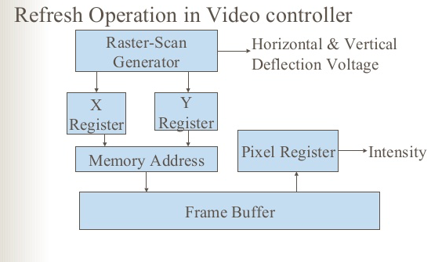
Basic refresh operations of the video controller
Two registers are used to store the coordinates of the screen pixels.
Initially, the x register is set to 0 and the y register is set to y_{max.}
Notes:
Fame buffer nd screen caartesian coordinates
Origin –lower left corner

Slide 52
The value stored in the frame buffer for this pixel position is then retrieved and used to set the intensity of the CRT beam.
Then the x register is incremented by 1, and the process repeated for the next pixel on the top scan line. This procedure is repeated for each pixel along the scan line.
After the last pixel on the top scan line has been processed, the x register is reset to 0 and the y register is decremented by 1. Pixels along this scan line are then processed in turn, and the procedure is repeated for each successive scan line.
After cycling through all pixels along the bottom scan line (y = 0), the video controller resets the registers to the first pixel position on the top scan line and the refresh process starts over.

Slide 53
To speed up pixel processing, video controllers can retrieve multiple pixel values from the refresh buffer on each pass.
The multiple pixel intensities are then stored in a separate register and used to control the CRT beam intensity for a group of adjacent pixels.
When that group of pixels has been processed, the next block of pixel values is retrieved from the frame buffer.

Slide 54
Video Controller
For various applications, the video controller can also retrieve pixel intensities from different memory areas on different refresh cycles.
Also, some transformations can be accomplished by the video controller.
In addition, the video controller often contains a lookup table, so that pixel values in the frame buffer are used to access the lookup table instead of controlling the CRT beam intensity directly.
Finally, some systems are designed to allow the video controller to mix the frame-buffer image with an input image from a television camera or other input device

Slide 55
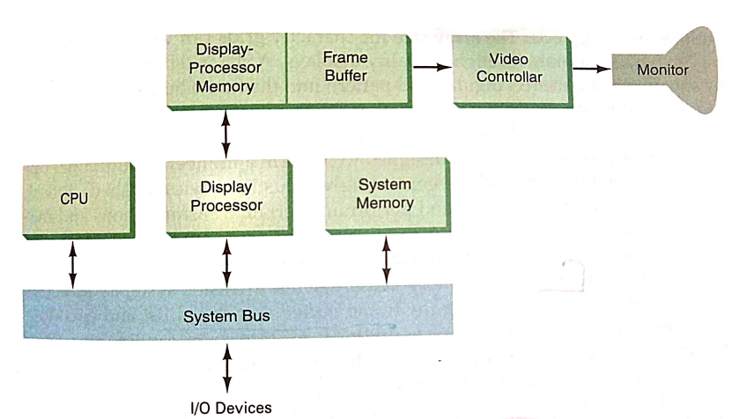
Raster-Scan Systems
Raster-Scan Display Processor
  Frees the CPU from the graphics chores
  Provide separate display-processor memory
  Architecture of raster-scan display system with display processor

Slide 56
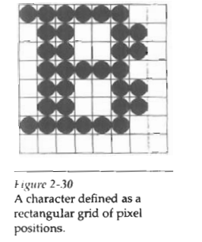
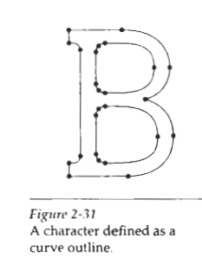
Display Processor
A major task of the display processor is digitizing a picture definition given in an application program into a set of pixel-intensity values for storage in the frame buffer. This digitization process is caIled scan conversion.
Graphics commands specifying straight lines and other geometric objects are scan converted into a set of discrete intensity points.
Scan converting a straight-line segment, for example, means that we have to locate the pixel positions closest to the line path and store the intensity for each position in the frame buffer.
Similar methods are used for scan converting curved lines and polygon outlines.
Characters can be defined with rectangular grids or they can be defined with curved outlines

Slide 57
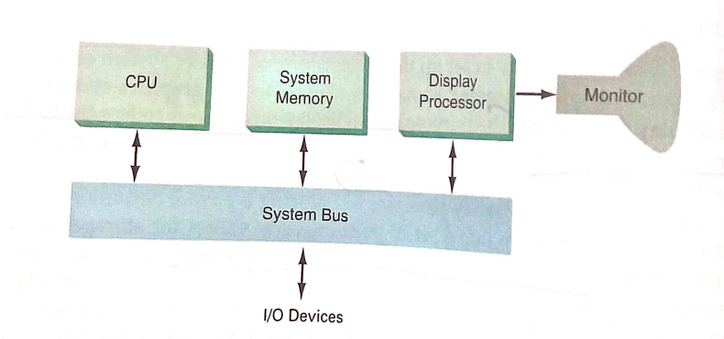
RANDOM-SCAN SYSTEMS
Architecture of Random Scan System

Slide 58
RANDOM-SCAN SYSTEMS
An application program is input and stored in the system memory along with a graphics package.
Graphics commands in the application program are translated by the graphics package into a display file stored in the system memory.
This display file is then accessed by the display processor to refresh the screen.
The display processor cycles through each command in the display file program once during every refresh cycle.
Sometimes the display processor in a random-scan system is referred to as a display processing unit or a graphics controller.

Slide 59
RANDOM-SCAN SYSTEMS
Graphics patterns are drawn on a random-scan system by directing the electron beam along the component lines of the picture.
Lines are defined by the values for their coordinate endpoints, and these input coordinate values are converted to x and y deflection voltages.
A scene is then drawn one line at a time by positioning the beam to fill in the line between specified endpoints.

